Slide 1
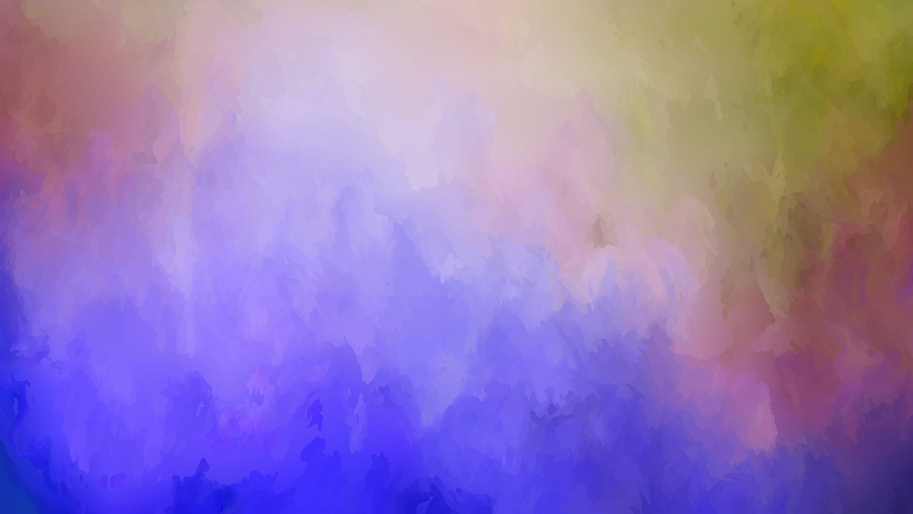
Alice’s Dream Land
Challenge Wk1, Rowan, Sienna, Ngozi

Slide 2

The Story:
Alice looked around at the ethereal place she had found herself in, confused as to quite how she’d got here.
She’d only wanted to catch up with the little white rabbit, not follow him down the rabbit hole.
But now, here she was, by a stream surrounded by cherry blossom trees.
There was a bridge in front of her and she contemplated walking along it to see where it would lead.
She’d already ended up in the rabbit hole, she thought, it couldn’t really get much worse. She might as well explore.
As she started moving, she took note of what she was wearing. She was in full armour with a blue sheen. She’d thought she’d been wearing a blue floaty dress when she followed the rabbit. Wondering if she was going crazy she tried to shake the thought and continued along the bridge.

Slide 3
The Scene:

